Slide 1


ANALYTICS HACKATHON
Aman Mehra
Chethan Mittapalli

Slide 2
AGENDA
Problem Statement
Process
Criteria
Insights
Roadmap

Slide 3
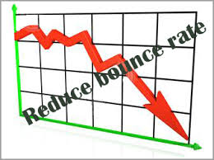
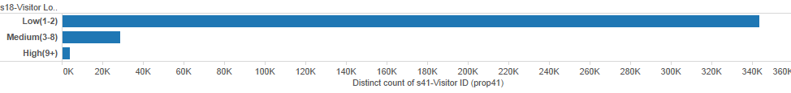
Web company wishes to reduce bounce rate They wish to improve the “Most Viewed section” as an initiative in that direction.
High Bounce rate
No Personalization
Uncover distinct customer segments to help personalization of most viewed section.
Best time to update videos after publication.

Slide 4
Web company provided us with Data We transformed it into Information
1. Inserted all records into mySQL database.
8.8 million records
2. Primary key presented by CSM : VisitorID
3. Cleaned on basis of any missing records.
7.8 million records
4. Primary key we selected was :
“Visitor ID + Remote ID + Transaction Day + Transaction Hour”
5. Cleaned on basis of the primary key above.
500,000 records

Slide 5
Web data was analyzed from 4 angles This will also serve as criteria for personalization
Dimensions | Attributes
Location | Referring subdomains Section/Subsection Days
Time | Weekend/ Weekday Morning, Afternoon, Evening, Night
Content | Author Geo
Loyalty | Story source Aspect

Slide 6
Web company will find some insights ‘interesting’ These insights can also serve as helpful guideline for personalization
LOCATION
Innovation is read more in East coast than West coast
East coast likes USA - related news than West coast
Chicago cares the least about world, or books, or energy!
Los Angeles has most “medium loyal” readers - they care the most about the world stories
Association rules based on Location
– East, West, North, South
Notes:
Click through rate increases
Ad revenue increases

Slide 7
Visitors are more active during weekdays
TIME
People are more “energy conscious” on weekends.
People read more on weekdays than weekends
- publish and update during weekdays!
Thursday evenings are the best (after office hours)
Early morning publishing have worst performance
Association rules based on Time of the day

Slide 8
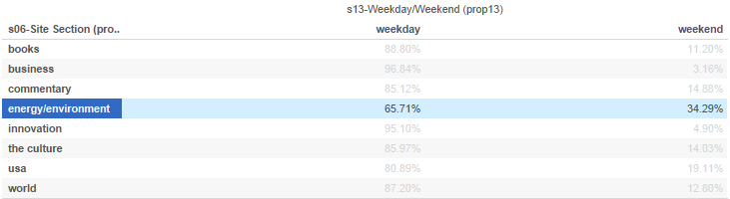

Slide 9
US and World news are favorites Engaging activities and news keep users on site
CONTENT
USA, Business, World - top favorite topics
Although web company source has most number of readers, Guest blogger stories are very popular in number of readers per story
Quizzes keep people occupied ( more page depth) on weekdays!
Association rules based on
Ratio of content: viewership

Slide 10
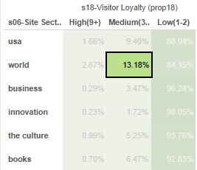

Slide 11
LOYALTY
People are more loyal to quizzes than articles and blogs - highest bounce rate on articles
Provide more links to quizzes
People from Google news are medium loyal readers
MS’s struggles continue - Bing has the lowest loyal readers
Association rules based on Loyalty in
Subdomain, Content type, Time

Slide 12
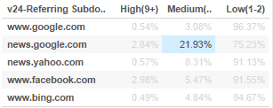

Slide 13
Update videos within 6-7 hours for max views Users like to be updated with videos sooner than later
Views
More than 70% of US news views happen within 6 hours
65% viewers prefer to view world news articles for which videos are updated at exactly 6 hours
Update innovation articles after 4 hours to increase views by more than 85%
Energy articles need to be updated within 2 hours for getting more than 90% views
Business articles updated between 6-7 hours are viewed by more than 60% of visitors

Slide 14
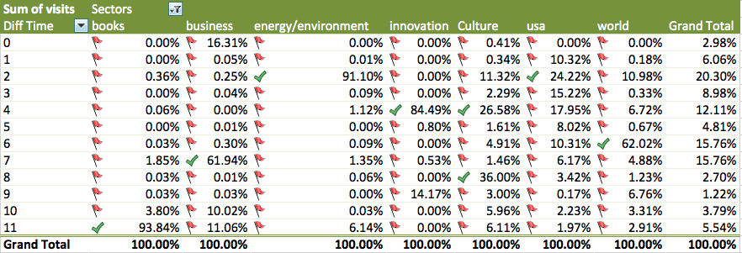
Analyzing the Update puzzle

Slide 15
RECOMMENDATIONS

Slide 16
Start the “Beta Testing” from tomorrow But it will take an iterative process and some time to get where they want
New modules
In other similar news
By the same author
People in your city also viewed
Personalize by Subdomain
Personalize by Location, Time
Personalize by Type of Content
Build a Data Model to track and monitor
Model stabilizes after teething problems

Slide 17
THANK YOU
CHETHAN – cmittapalli1@babson.edu
AMAN – amehra2@babson.edu

